Slide 1
ER Diagrams (Conceptual, Logical)
Team 2: UnitFit

Slide 2
FreemiumID
Trainer’s ID
Online Users ID
Trainer’s Name
Online Users ID
Trainer’s Email
Freemium
Subscription
has
Trainer
Sponsored User ID
Online Users ID
Subscription ID
Trainer’s ID
IsA
has
Payment ID
Calendar Tracking
Freemium ID
Account Number
Workout Type
Subscription ID
Plan
Tracking Calories
Dashboard
Card Type
CVV
Workout Level
Payment
Tracking Workouts
choose
Tracking weight
User ID
Valid Year
Tracking Time
Email
Valid Month
FName
User
access
LName
Phone number
generate
Password
IsA
Bill ID
Online Users
Payment ID
Email
Sponsored Users
Bill
Plan’s ID
Freemium ID
Online User ID
Team 2: UnitFit
ER Diagram (Conceptual)
Sponsored Users ID
Payment Date
Payment Amount

Slide 3
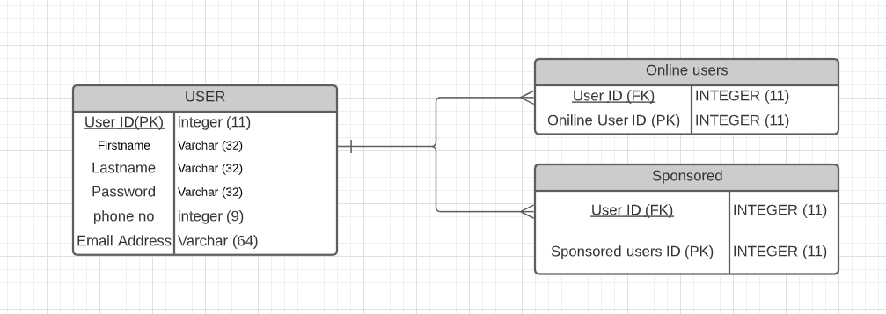
Team 2: UnitFit
ER Diagram (Logical) - Fall Semester

